Slide 1
VTC Regional Center and Future work
Dr. Ziad Abu El-Rub German Jordanian University | Dr. Fahmi Al Balawneh Almotahida Education Group
Leipzig, Germany | 29 Sep. 2018 - 2 Oct. 2018

Slide 2
Nominated VTC Regional Center
GJU – VTC was nominated to be the physical regional center for the project
Almotahida Education Group was nominated to be the virtual regional center of the project
The two nominated partners represent the VTC regional center

Slide 3
Duties of the VTC Regional Center
Represent partners of the project
Demonstrate and transfer the VTC - experience locally and internationally.
Work sustainability

Slide 4
Future Work
List of annual future activites
Hawwaz Vocational Training Center

Slide 5
Hawwaz Vocational Training Center

Slide 6
About Hawwaz VTC
Vocational Training Platform
Provides opportunities to enroll in digital training courses in all fields
Qualify graduates to enter the market
Develop the professional performance of employees in companies and various institutions
Training materials are prepared by a distinguished elite of trainers and content specialists at anytime and anywhere.
Interactive educational environment which employs web-based technology, techniques and tools
Quick administration with the least costs
Digital publishing features, assignments, and e- tests, and supervision
high quality training outcomes to meet the changing needs of the market

Slide 7
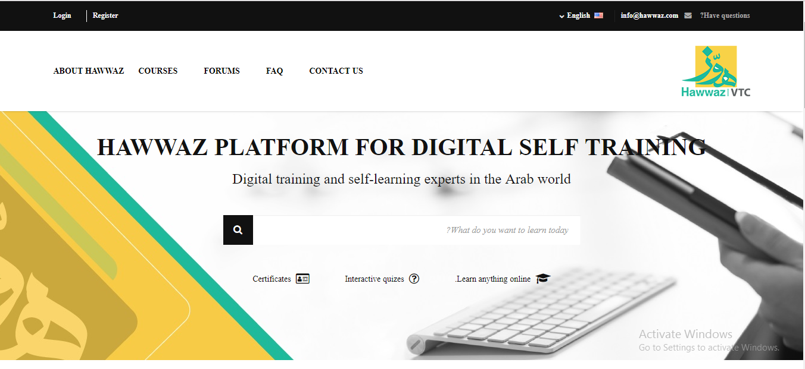
Vtc.hawwaz.com

Slide 8
Hawwaz VTC MISSION
Train and qualify the graduates according to the market needs.
Develop the employees performance in institutions, preparing them to cope with changes, and developments in knowledge and technology, And interact with the achievements of the age of knowledge and technology professionally and competently.

Slide 9
Hawwaz VTC GOALS
Generic vocational skills and competencies of graduates and employees.
Preparing professional skill lists according to market needs.
Analysis of required qualifications in the market.
Preparation of programs and vocational diplomas based on the job market requirements.
Digital training of all types: Live (Online), Self-learning, Flipped and Blended.

Slide 10
Center Hierarchy
Guidance
AEG Director
GJU President
Management
Hawwaz Coordinator
GJU Coordinator
GJU Dr. Ziad
Hawwaz Dr. Fahmi
Consultants
Dr. Riyadh Qashi
Dr. Johana Paluchov
Dr. Paulo Paptista
Dr. Ziad Abuelrub
Dr. Tareq AlAzab
Dr. Omar AlMaayta
Dr. Ahmad salaymeh
Dr. Fahmi Abu Alrub
TRAINERS who Trained during the VTC Project

Slide 11
Resources
The needed documents:
Project Profile
Flyers and Brochure
Presentation
others
Center website (vtc.hawwaz.com)
Outlines and the work package
Marketing Plan

Slide 12
Partners

Slide 13
Thank you!

